Slide 1


Working with Settings
Working with Threads
Damir Dobric
Microsoft PTSP (Partner Technical Solution Specialist) Microsoft Most Valuable Professional
Blog
Twitter
damir.dobric@daenet.com

Slide 2


+++ Live +++ +++ Live +++ +++ Live +++
Welcome
to
Software Engineering
Lesson WS2022/2023
Starting at 14:15
survey

Slide 3

+++ Live +++ +++ Live +++ +++ Live +++
The rule No1
Keep your camera on

Slide 4

+++ Live +++ +++ Live +++ +++ Live +++
Software Engineering
WS-2022-2023
Lesson Mo.
14.15-15.45 h
16.00-17.30 h
17.45-19.15 h
Lab: Wed.
08.15-11.30 h
Room 8-A14
https://www.linkedin.com/groups/8689804

Slide 5
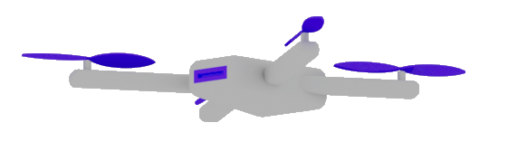

Thank you for watching!
Thank you for joining us for this year's .NET Conf
to celebrate the release of .NET 7.

Slide 6
Object Oriented Programming
Configuration & Settings
Working with Threads
Damir Dobric
Microsoft Regional Director Microsoft Most Valuable Professional
Blog
Twitter
damir.dobric@daenet.com https://about.me/damirdobric

Slide 7
Object Oriented Programming
Object Oriented programming (OOP) is a programming paradigm that relies on the concept of classes and objects.

Slide 8
Classes

Slide 9
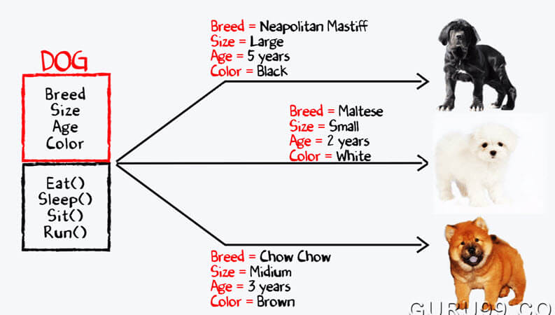

Slide 10
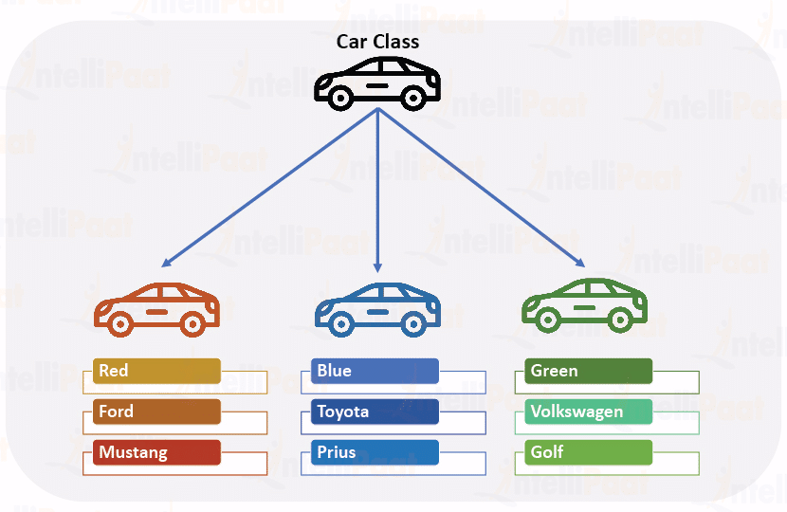

Slide 11
Classes
public class MyClass {
private int Counter;
public int Status
{
get
{
return Counter * 2;
}
}
public int object GetResult(string arg)
{
return arg.Length;
}
}
Field
Property
Method

Slide 12
Interfaces

Slide 13
Interfaces
Interface is a contract.
It does not execute. It defines what to implement and how to use it.
You always need an implementation of an interface
There might me multiple implementations of the same interface
public interface IMyInterface {
object GetResult();
void Train(double[] data);
}

Slide 14
Thank you for watching!
Thank you for joining us for this year's .NET Conf
to celebrate the release of .NET 7.

Slide 15
Dependency Injection
Thank you for watching!
Thank you for joining us for this year's .NET Conf
to celebrate the release of .NET 7.
Architectural principles | Microsoft Learn

Slide 16
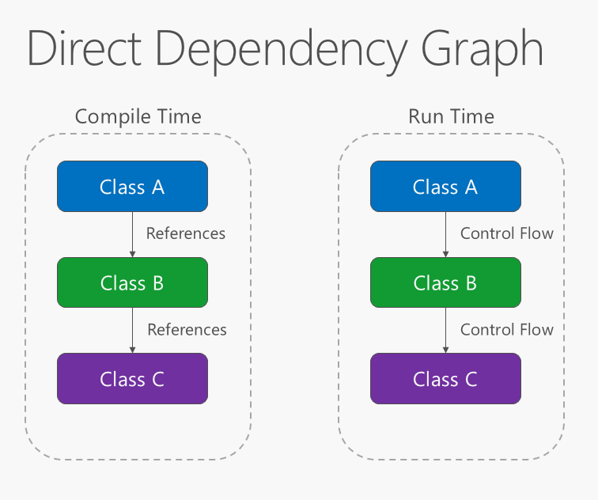

Slide 17
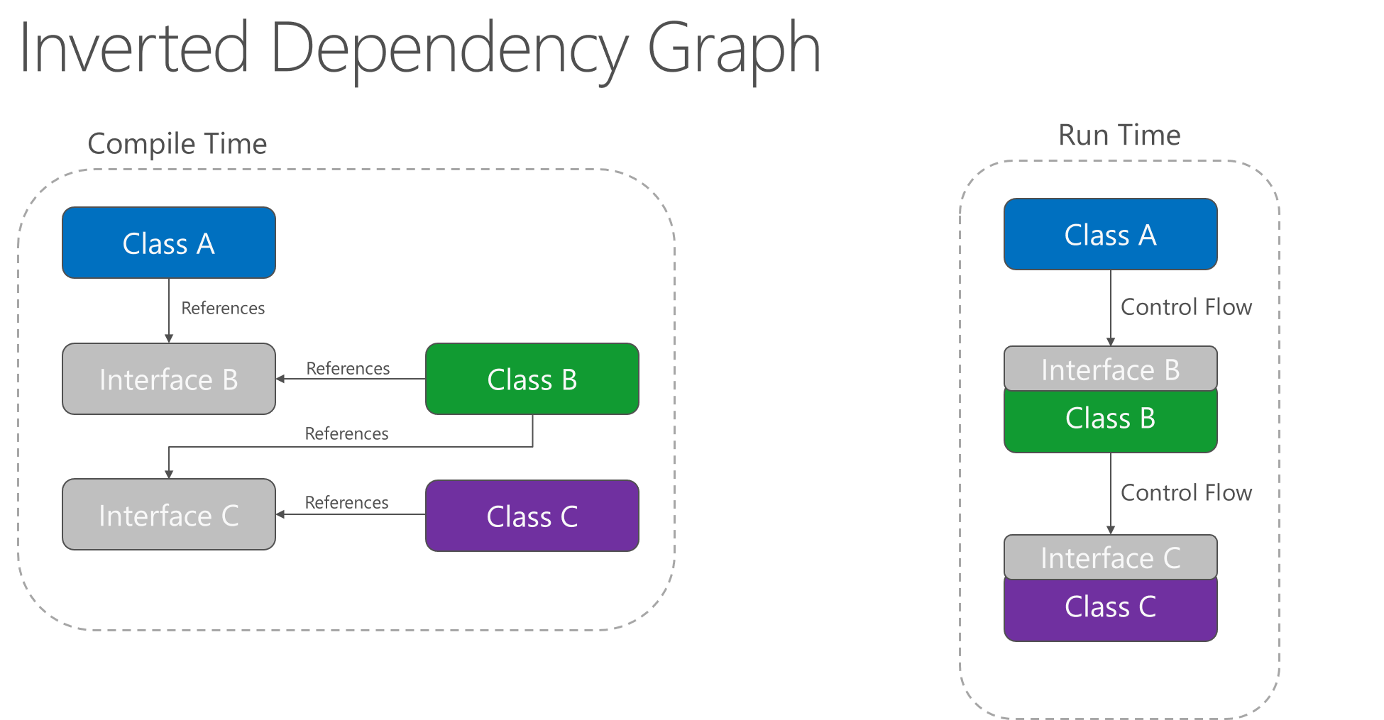

Slide 18
Inversion of Control
Dependency Injection
Constructor Injection
Setter Injection
Service Locator
Setter Injection
public class MyClass {
[Inject]
private MyClass2 MyClass2 { get; set; }
public MyClass(AnyOtherClass injectedInstance) {}
}
Constructor Injection
IMyInterface printer = svcLoc.GetService<IMyClass>();

Slide 19
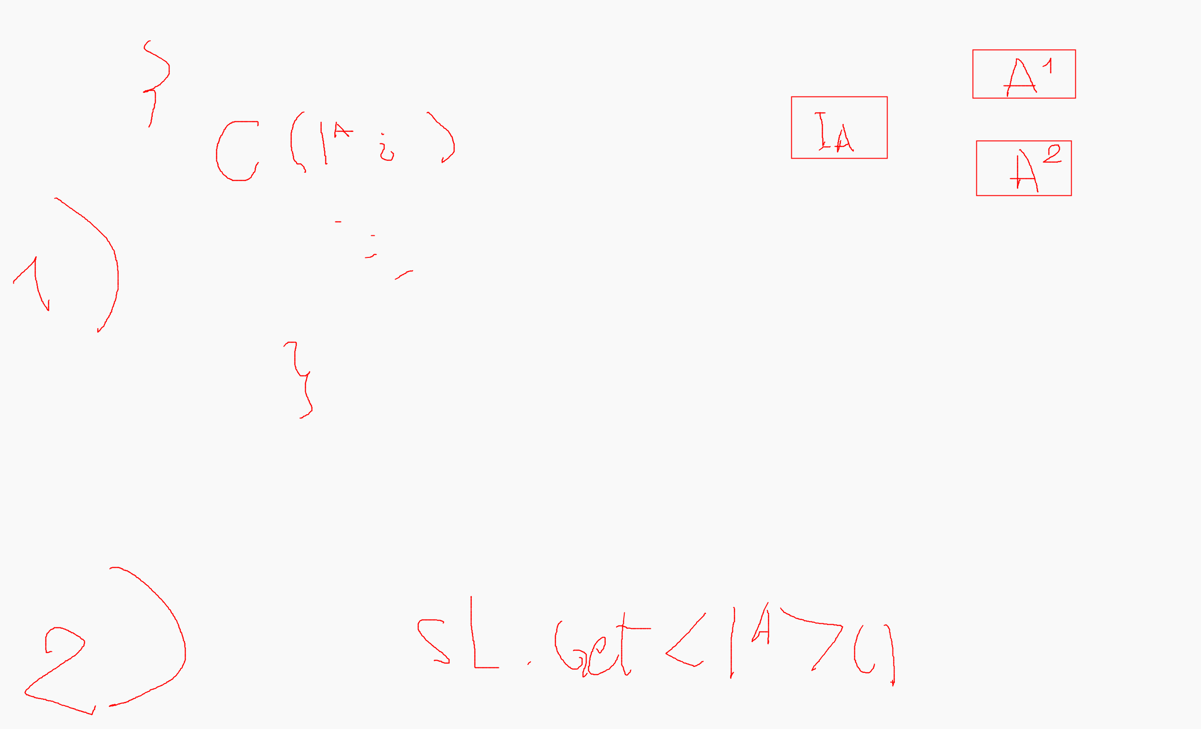

Slide 20
Configuration and Settings
In .NET
Thank you for watching!
Thank you for joining us for this year's .NET Conf
to celebrate the release of .NET 7.
Starting soon...

Slide 21
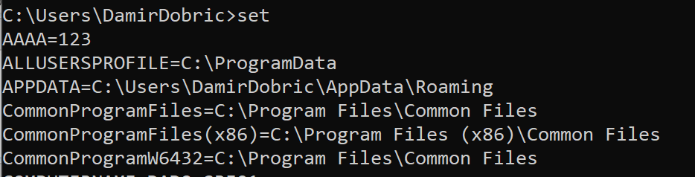
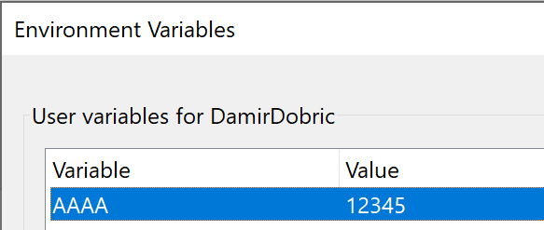
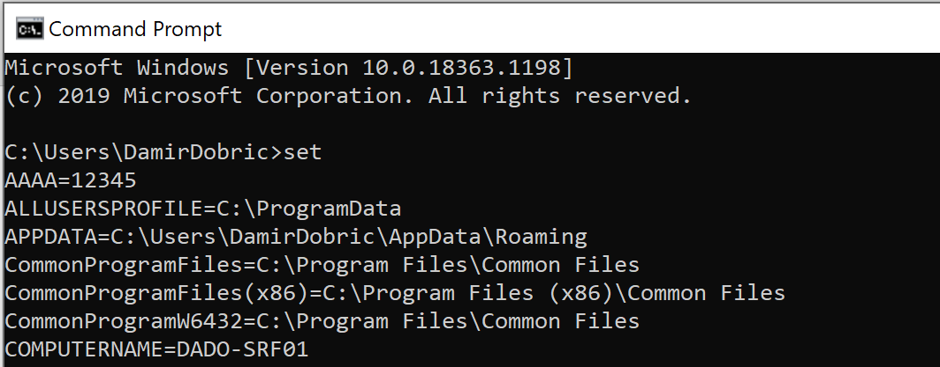
Environment Variables
Open command line and execute this to show all variables in the environment
> set
> setx AAAA 1234
Set specific variable

Slide 22
Configuration of an application
Command Line Arguments
Started by user, script,..
Environment Variables
Same Program
Configuration File

Slide 23
Examples: Command Line Arguments
myprogram.exe --mysetting xy
myprogram.exe --color blue –sound yes
dotnet –list-sdks

Slide 24
Examples: Settings
{
"Setting1": "Hello :)",
"Setting2": 123,
"Setting3": 7.21
}
{
"Setting1": "Hello :)",
"Setting2": 123,
"Setting3": 7.21
}

Slide 25
How to read settings (configuration)?
private static ConfigurationBuilder m_Builder;
private static IConfigurationRoot m_Config;
public static void Main(string[] args) {
m_Builder = new ConfigurationBuilder();
m_Builder.AddJsonFile(“MySettings.json”);
m_Builder.AddCommandLine(args);
m_Config = m_Builder.Build();
Console.WriteLine(m_Config[“Setting1”];
}

Slide 26
How to read nested settings?
{
"Setting1": "Hello :)",
"Setting2": 123,
"Setting3": 7.21,
"SubSettings": {
"Setting1": "Hello from sub settings :)",
"Setting2": 123444,
"Setting3": 777.21
}
}
private static ConfigurationBuilder m_Builder;
private static IConfigurationRoot m_Config;
public static void Main(string[] args) {
m_Builder = new ConfigurationBuilder();
m_Builder.AddJsonFile(“MySettings.json”);
m_Config = m_Builder.Build();
Console.WriteLine(m_Config.GetSection(“section”)[“Setting1”];
}

Slide 27
Working with Threads-
Parallel & Concurrent execution

Slide 28
Sequential vs. Parallel processing
Sequential
Concurrent
Parallel
Multithreaded

Slide 29
Sequential Execution
for (int i = 0; i < 100; i++)
{
doAnything(null);
}

Slide 30
Multithreading
for (int i = 0; i < threads; i++)
{
var t = new Thread(new ParameterizedThreadStart(doIt));
t.Name = i.ToString();
t.Start(new Action<string>(onThreadFinished));
}
private static void doIt(object onFinishDelegate)
{
doAnything(null);
}

Slide 31
Task Parallel Execution
List<Task> tList = new List<Task>();
for (int i = 0; i < threads; i++)
{
var t = new Task(doIt, “some object”);
tList.Add(t);
}
foreach (var t in tList)
{
t.Start();
}
Task.WaitAll(tList.ToArray());
private static void doIt(object someObjectSate)
{
// . . .
}

Slide 32
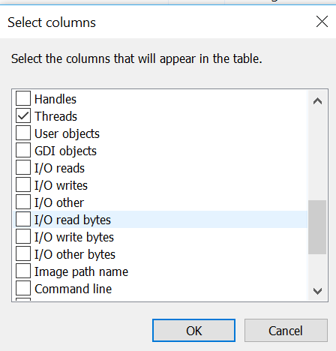
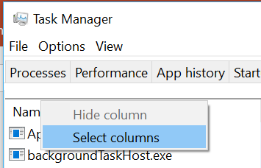
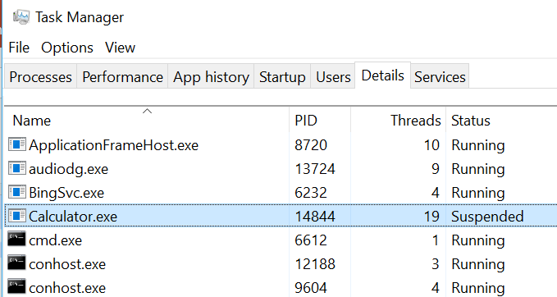
Task Manager

Slide 33
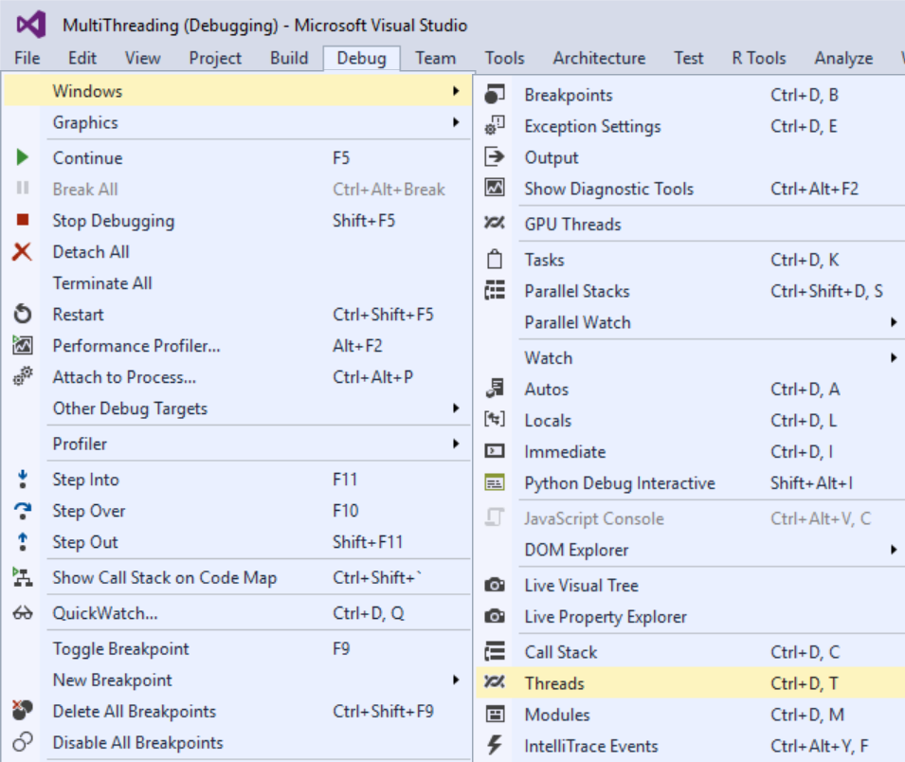
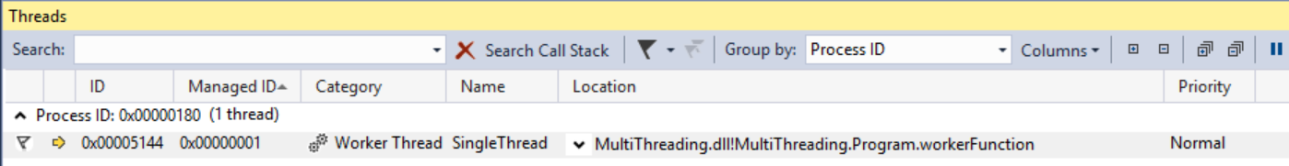
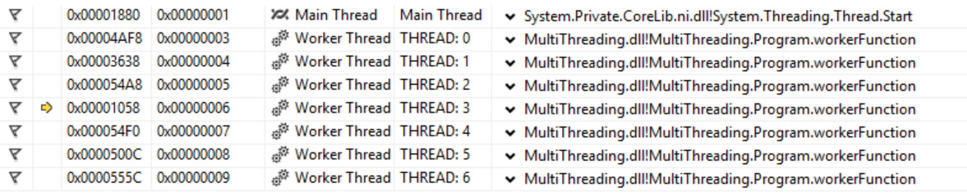
Threads in Visual Studio

Slide 34
Exercises
E7 - Reading configuration
E8 - Interfaces and Classes
E9 - Parallel Processing and Concurrency

Slide 35
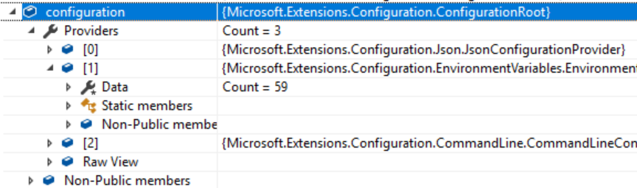
Exercise E7 – Reading Configuration
Implement a simple console application that demonstrates working with configuration: AppSettings, CommandLine Arguments and Environment Variables. Add nugets:
Microsoft.Extensions.Configuration
Microsoft.Extensions.Configuration.Binder
Microsoft.Extensions.Configuration.EnvironmentVariables
Microsoft.Extensions.Configuration.FileExtensions
Microsoft.Extensions.Configuration.Json
Microsoft.Extensions.Configuration.CommandLine
Add new file ‘appsettings.json’ to the project
Next slide shows an example.
Add Code for reading settings
See next slides for example.

Slide 36
appsettings.json
{
"Setting1": "Hello :)",
"Setting2": 123,
"Setting3": 7.21,
"SubSettings": {
"Setting1": "Hello from sub settings :)",
"Setting2": 123444,
"Setting3": 777.21
},
"MySetting": {
"SomeInt": "77",
"SomeString": "Hello :)",
"SomeFloat": 12.1
}
}

Slide 37
Sample Code
static void Main(string[] args)
{
var builder = new ConfigurationBuilder()
.SetBasePath(Directory.GetCurrentDirectory())
.AddJsonFile("appsettings.json", optional: false, reloadOnChange: true)
.AddEnvironmentVariables();
if (args != null) { builder.AddCommandLine(args);
}
IConfigurationRoot configuration = builder.Build();
// // Following are coming from command line. var color = configuration["color"]; var fontSize = configuration["fontSize"]; //TODO // Write to the console all configuration values.
// Run the application from command prompt and provide config args.
// Change some settings in the appsettings files and run the application again
// Set some environment variables via PowerShell or Windows UI.
// Run the application again and notice changes. }

Slide 38
Exercise E8 – Interfaces and Classes
Define some interface or use IMyInterface from this presentation. (See slide 9)
Create two classes, which implement interface by using two different approaches. For example:
Method train could calculate sum of all values specified in data and set result to 1 if the sum is greater than 100 and 0 if sum is less than 100.
Second implementation could use some different rule. For example Train would calculate Average value, Median and Variance. All named results can be provided as properties of some class called Result. Method GetResult would return instance of class Result.
Please note that method Train can be called multiple times. It means implementation of interface must remember calculated result.
3. Extend interface with methods Save and Load. Save should save currently calculated (trained) result and Load should load saved result on next application start

Slide 39
E9 - Parallel Processing and Concurrency 1/2
Run a job in Sequence
Execution job after job.
Run every job in its own thread
Optimal: If number of processors (cores) equals num. of threads.
Context switches: if num. of threads higher than num of processors (cores).
OS need time for managing of context switches.
Run jobs as parallel Tasks
Internal scheduler fires optimal num. of threads
Internal scheduler reuses threads.

Slide 40
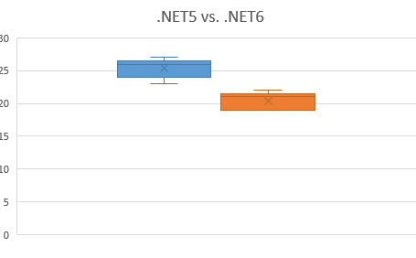
E9 - Parallel Processing and Concurrency 2/2
Implement your own worker.
Provide test results as diagrams in Excel for all 3 approaches
Outputs
Execution time
Max number of threads during execution
Excel Diagram
Inputs:
Test Name (Approach)
Test with numThreads = {50, 100, 150}
Number of processors (Affinity in TaskMgr) {1, 2, 4, ?}
All tests for .NET Core 5.0 vs. ,NET 6.0 with self-contained and framework dependent publish.
Provide diagrams in the Excel table that compare .NET5.0 and .NET 6.0

